Slide 1
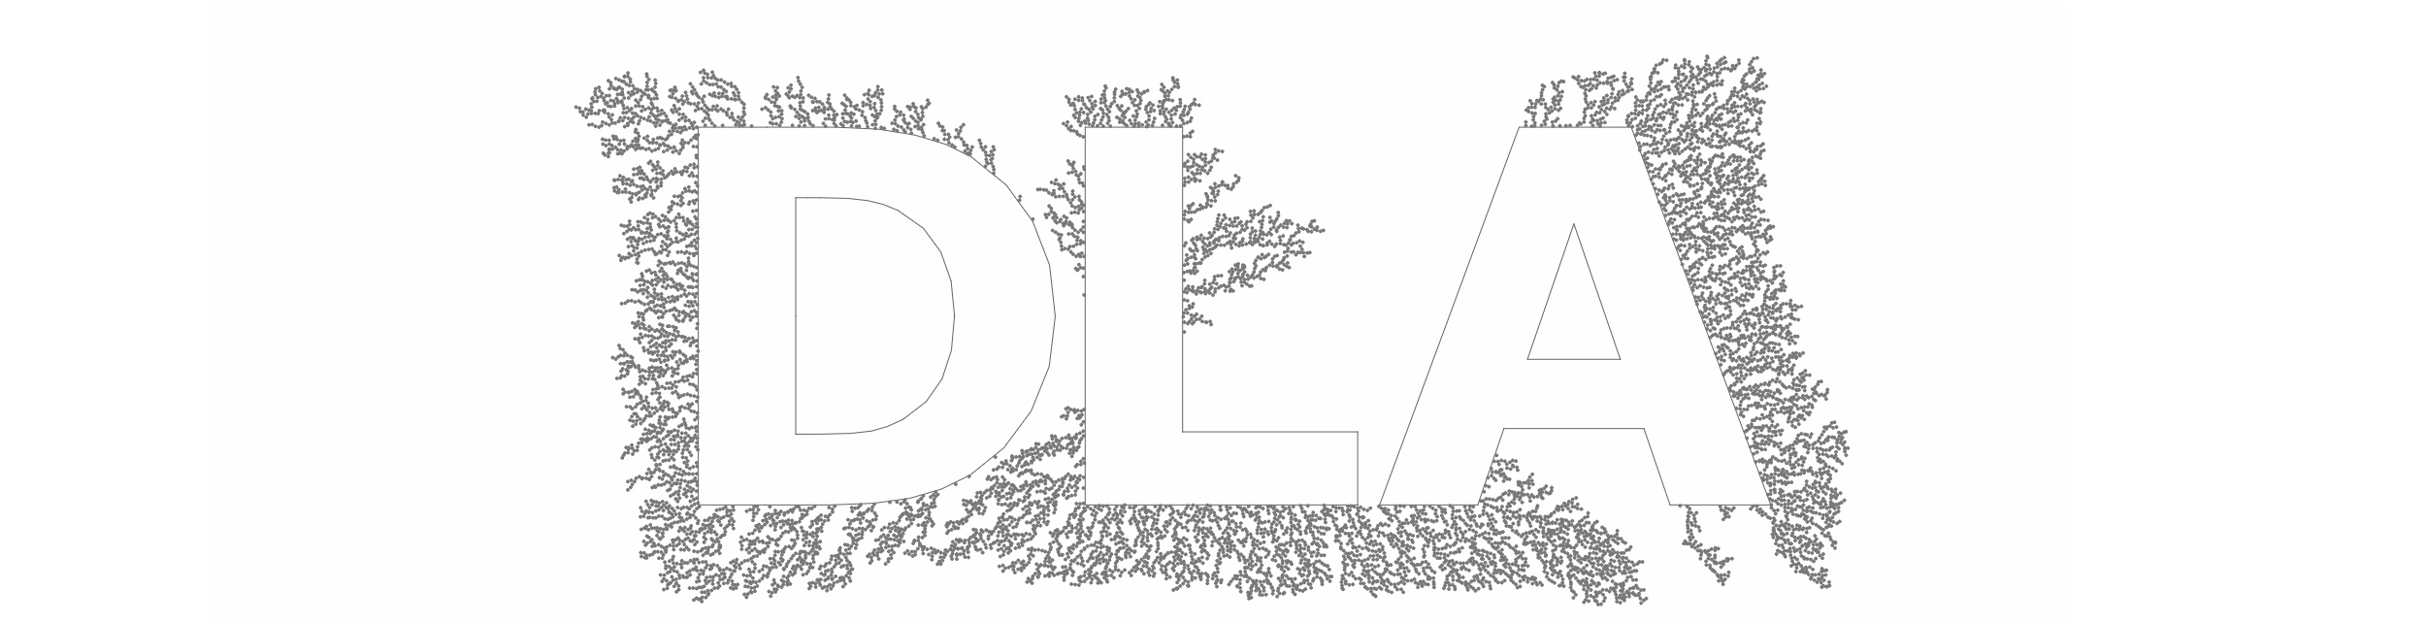
Diffusion-limited aggregation

Slide 2
01
What‘s DLA

Slide 3
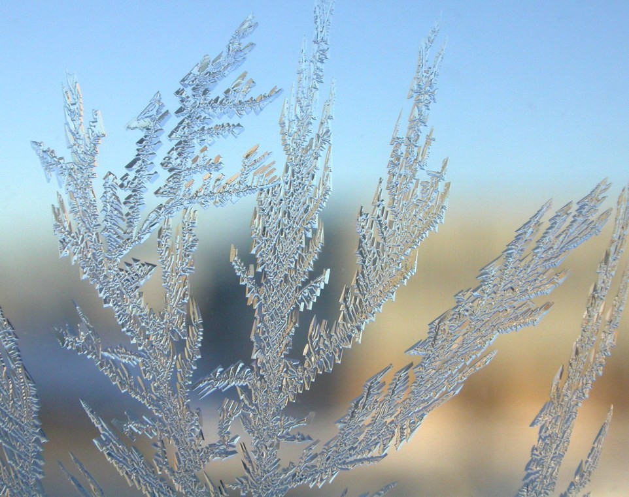
ABOUT US
The process whereby particles undergoing a random walk due to Brownian motion cluster together to form aggregates of such particles.
proposed by T.A. Witten Jr. and L.M. Sander in 1981

Slide 4
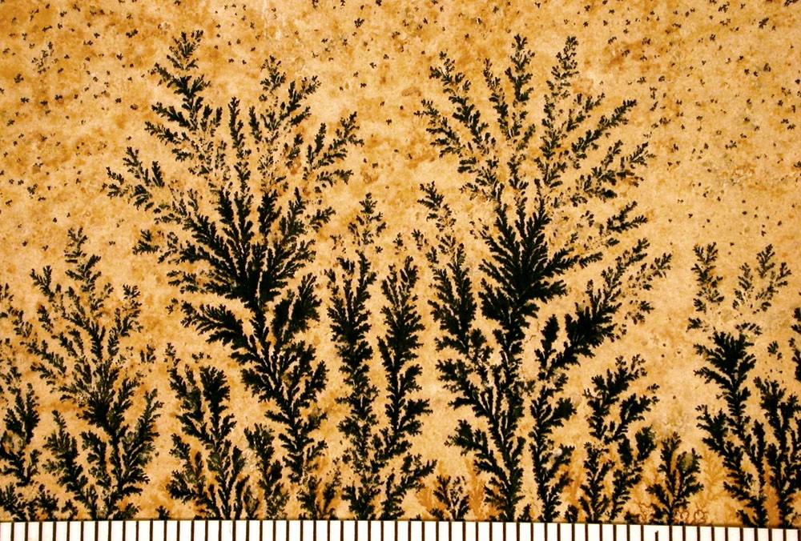
Brownian trees
The clusters formed in DLA processes are referred to as Brownian trees. These clusters are an example of a fractal.
Fractal
a rough or fragmented geometric shape that can be split into parts, each of which is (at least approximately) a reduced-size copy of the whole

Slide 5
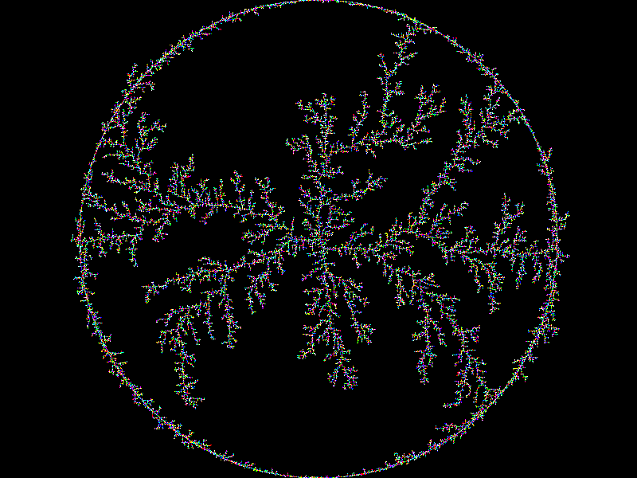
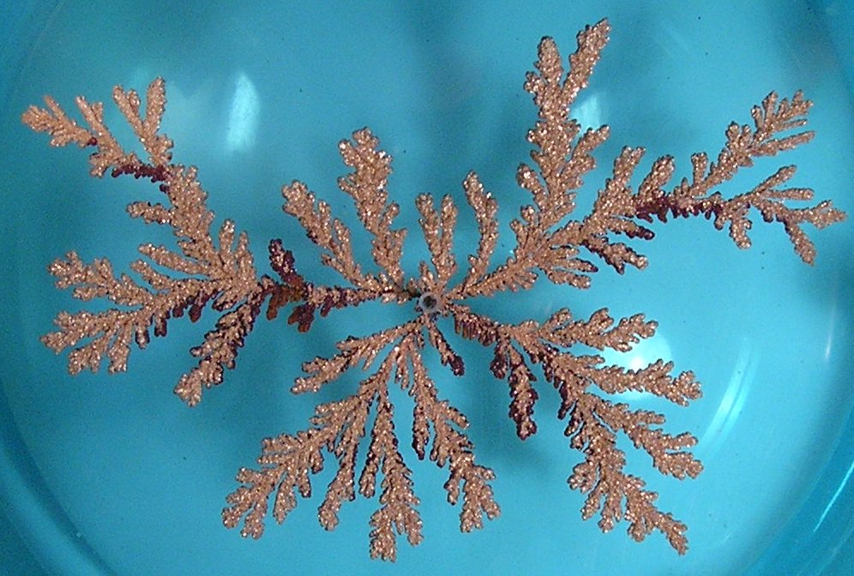
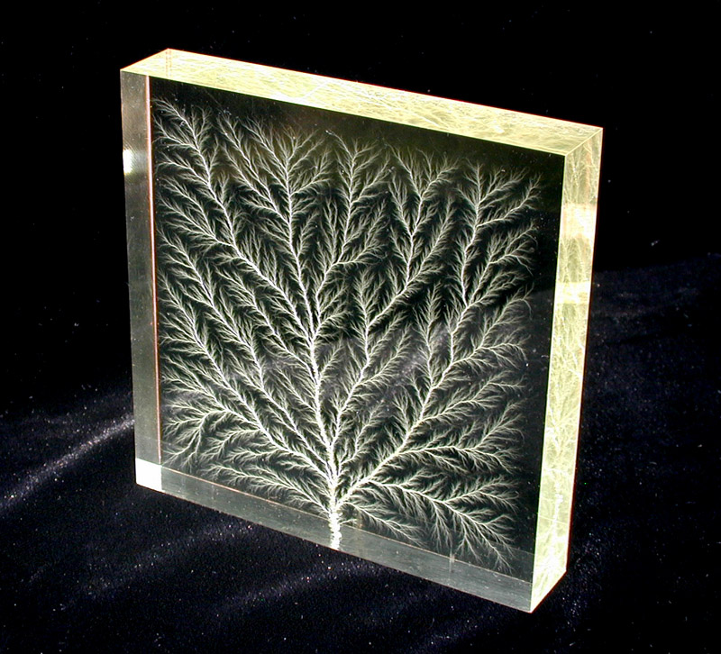
Examples

Slide 6
BASIC IDEA
First, set an initial particle as a seed, then generate a random particle at any position far from the seed and make it do a random walk, until it contacts with the initial seed and becomes a part of the group. Repeat the process so that a large DLA cluster can be obtained.

Slide 7
02
Factors

Slide 8
The speed position
The initial particle position

Slide 9
Directional forces

Slide 10
Particle sizes

Slide 11
Other factors
Temperature
Different shapes
The moving algorithm

Slide 12
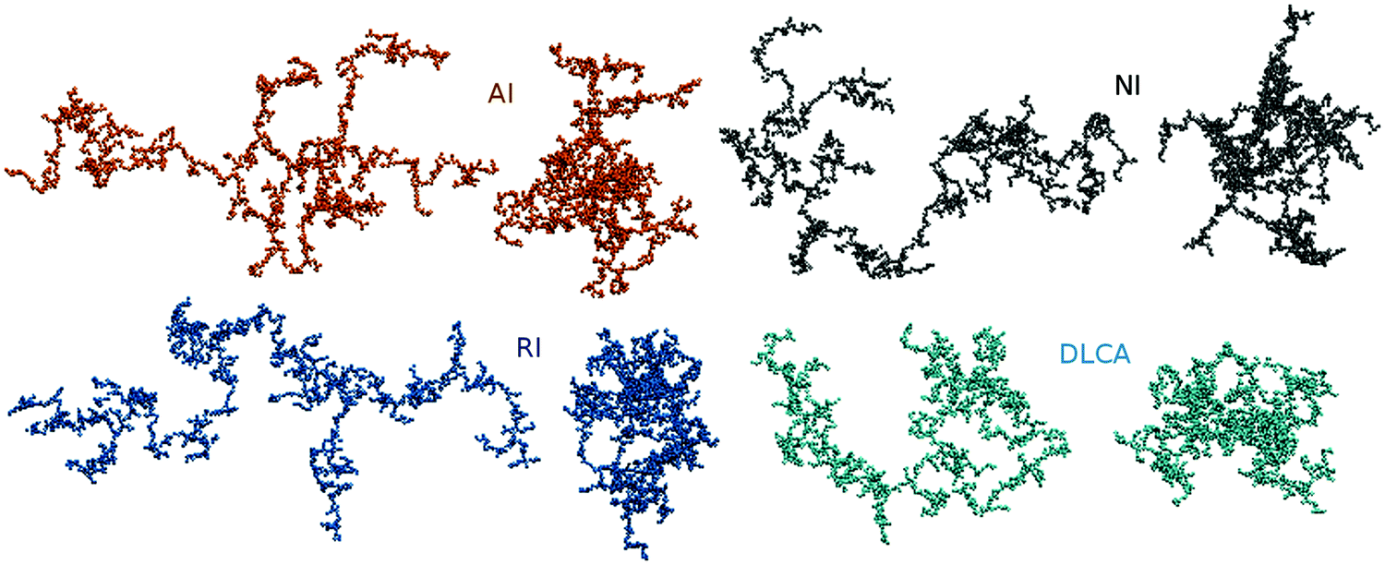

Slide 13
THANKS
Reference：
https://en.wikipedia.org/wiki/Diffusion-limited_aggregation
https://en.wikipedia.org/wiki/Fractal
https://medium.com/@jason.webb/simulating-dla-in-js-f1914eb04b1d
https://blog.csdn.net/liyuanbhu/article/details/8522144

